Slide 1


Voice and Accent

Slide 2
Introduction
In order to know the correct pronunciation certain symbols denoting the letter sounds have been devised and standardized. By learning these symbols you will be able to find the correct pronunciation of any word in a standard dictionary. These symbols will also help you to go through the book with guidance for correct pronunciation of words and conversations.

Slide 3
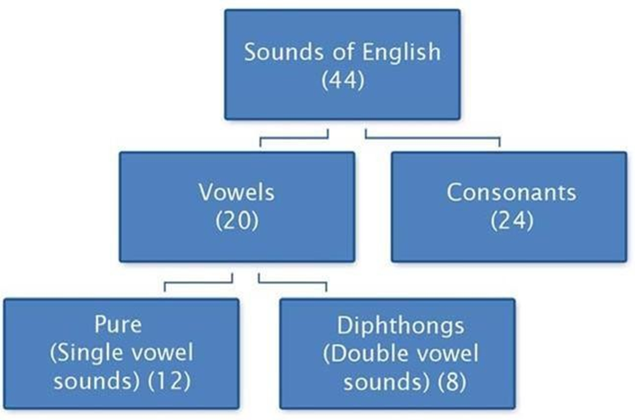

Slide 4
What is a vowel sound?
a, e, i, o, u
A speech sound that is pronounced without the lips, tongue, teeth or throat blocking the air produced when uttering the letter.
Give some vowel sound words:

Slide 5
What is Single vowel sound?
Single vowel sounds: When these sounds are produced, the tongue remains in the same position even when the sound is prolonged. They consist of one sound only and are called pure vowels as in ‘sit’, ‘pot’, ‘heat’, etc. (the underlined letters indicate the single vowel sounds)

Slide 6
What is Double vowel sound?
Double vowel sounds: These vowel sounds are a combination of two single vowel sounds and in pronouncing them the tongue moves from one position to another. For instance, in the word ‘light’ the the sound of ‘i’ is a combination of the vowel sounds
/a:/ as in ‘art’

Slide 7
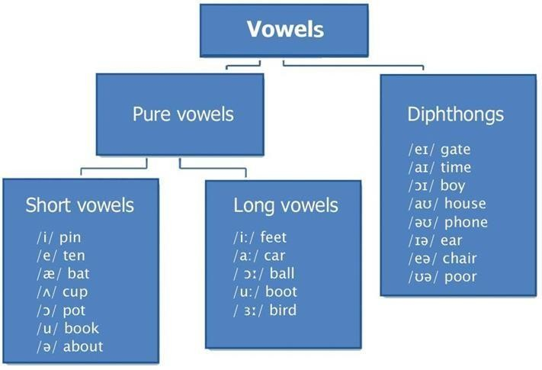
Vowels

Slide 8
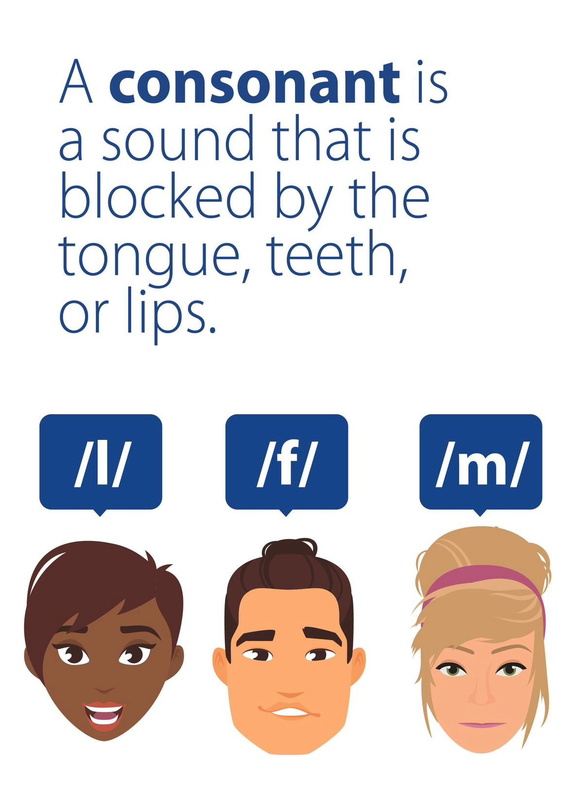
What is consonant sound?
A consonant is a sound that is produced by blocking air from flowing out of the mouth with the teeth, tongue, lips or palate. Consonants may come alone or in clusters but have to be connected to a vowel to form a syllable.

Slide 9
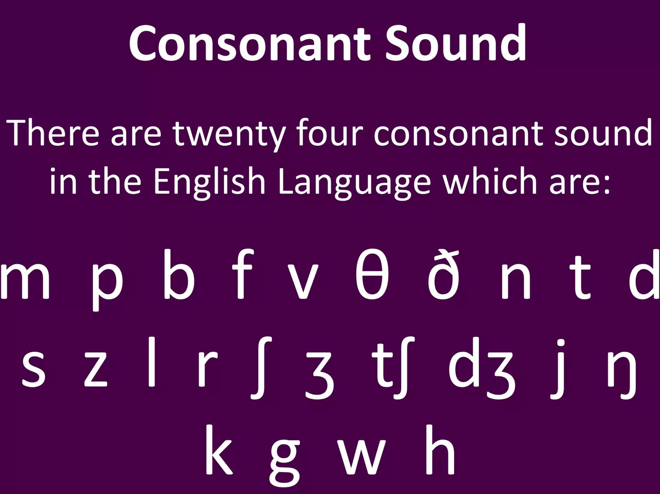

Slide 10
Let’s make some consonants sound words
/p/ /b/ /f/
/v/ /j/ /k/
/r/ /z/ /g/

Slide 11
Consonant sounds are divided into two broad buckets:
· Voiced Consonants-Plosive
· Unvoiced Consonants- Non Plosive Consonant sounds can be produced either with or without a Vibration of the vocal cord

Slide 12
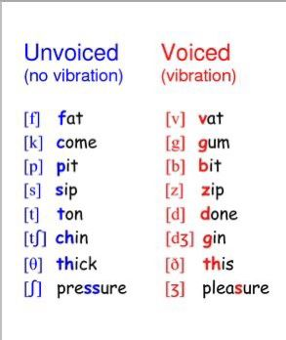

Slide 13
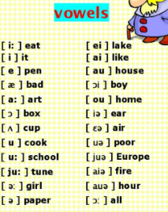

Slide 14
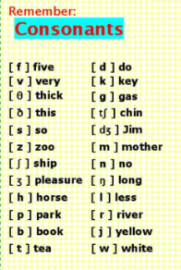

Slide 15
Quiz Time!
Which type of sentence tells someone to do something?

Slide 16
Quiz Time!
Which type of sentence shows great feeling and uses and exclamation point?

Slide 17
Thank you!

